Slide 1
Welcome
IPL Analysis
Sports Basics

Slide 2
Problem Statement
"Sports Basics" is a sports blog company that entered space recently. They wanted to get more traffic to their website by releasing a special edition magazine on IPL 2024. This magazine aims to provide interesting insights and facts for fans, analysts and teams based on the last 3 years' data.
Tony Sharma, the chief editor, runs the publication and is big on data analytics. He contacted Peter Pandey, a journalist on his team who loves cricket and is great with data.

Slide 3
Introduction
Today, we delve into realms of data-driven analysis, where cricket meets analysis, to uncover fascinating insights and trends from the past three years of IPL action.
Our mission at “Sports Basics” has always been to bring fans, analysts, and teams closer to the game they love through informative and engaging content.
Under the visionary leadership of our Chief Editor, Tony Sharma, and the expertise of our data-savvy journalist, Peter Pandey, we’ve meticulously crafted this special edition magazine to cater to the insatiable appetite of cricket enthusiasts.

Slide 4
Indian Premier League (IPL)
The Indian Premier League (IPL) is a professional Twenty20 cricket league in India.
It was founded by the Board of Control for Cricket in India (BCCI) in 2008.
The league features 10 teams representing different cities across India.
IPL has become one of the most popular and lucrative cricket leagues globally.
It combines top International crickets with emerging Talents, offering thrilling matches and entertainment for millions of fans worldwide.

Slide 5



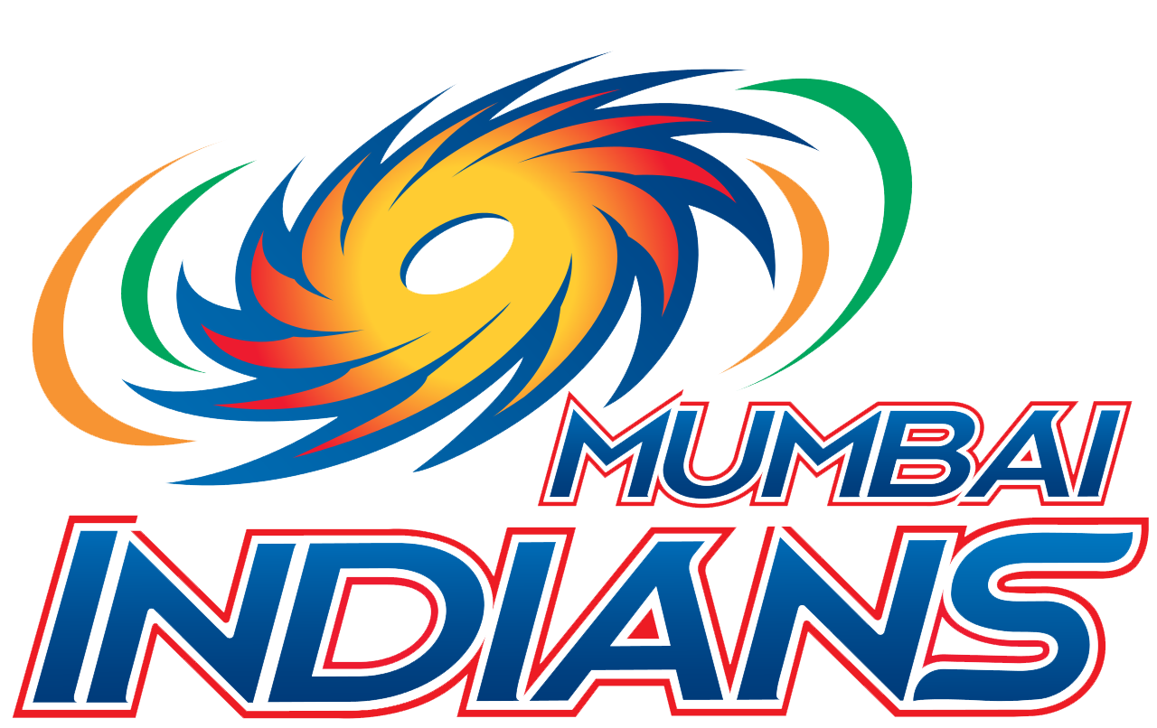



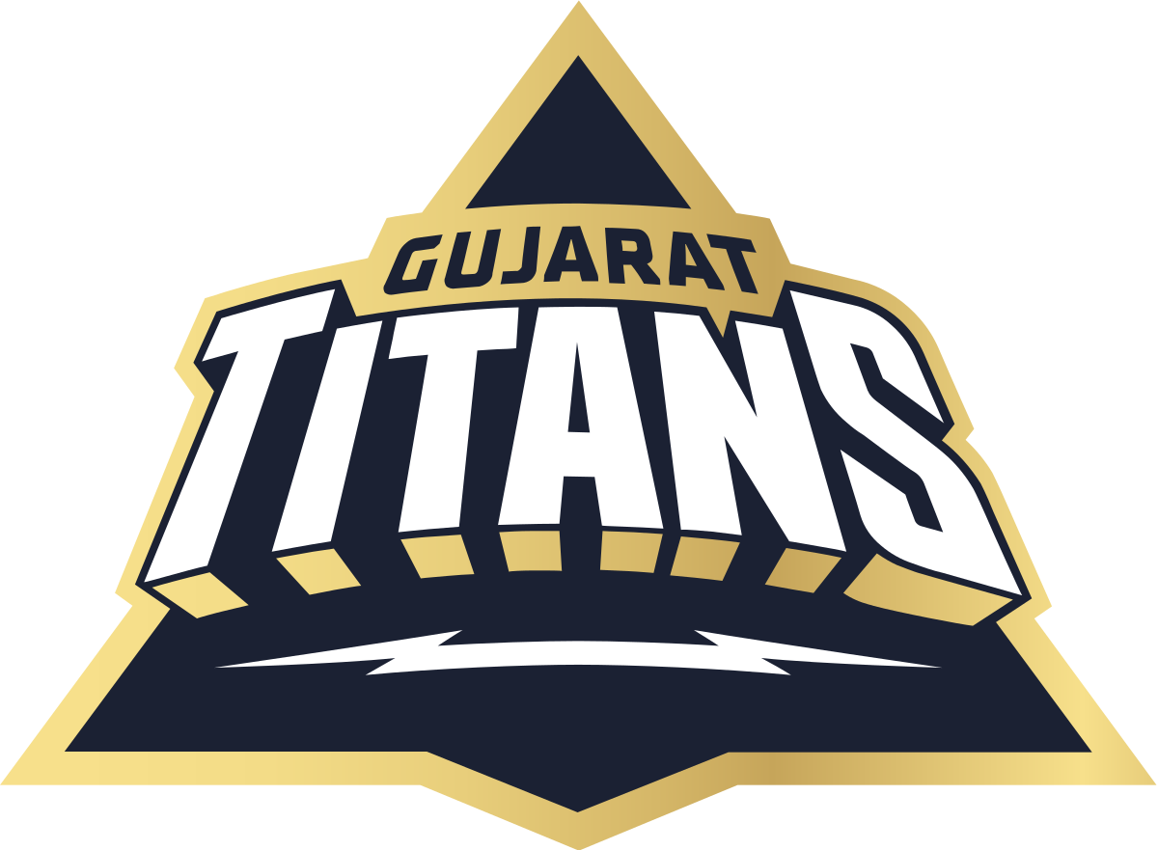
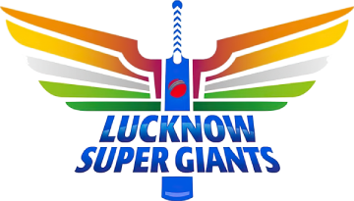

Teams
Chennai Super Kings
Delhi Captials
Royal Challengers Bangalore
Mumbai Indians
Rajasthan Royals
Kolkata Knight Riders
Sunrisers Hyderabad
Gujarat Titans
Lucknow Super Giants
Punjab Kings

Slide 6
Primary Analysis

Slide 7
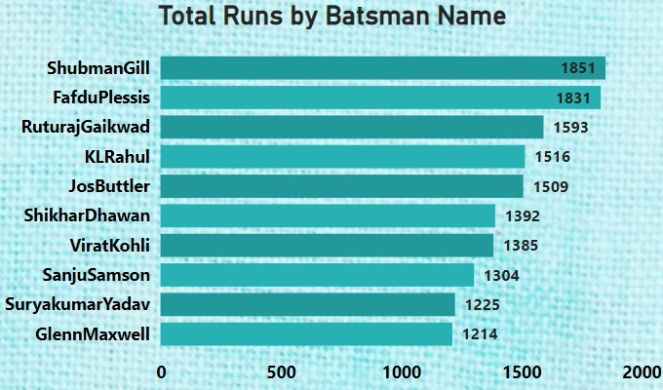
Top 10 Batsman based on Total Runs Scored
Shubaman Gill leads with 1851 runs.
Faf Du Pleassis follows closely with 1831 runs.
Ruturaj Gaikwad stands third with 1593 runs.
KL Rahul and Jos Butler are mid – range top performers.
Rahul scored 1516 runs , while Butler scored 1509 runs.
A significant gap exists between the top 3 and the rest.
Glenn Maxwell has the lowest tally among the top 10 and he scored 1214 runs during this period.

Slide 8
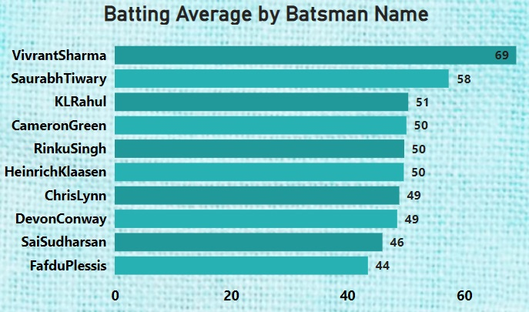
Top 10 batsmen based batting average
Vivrant Sharma leads with an impressive batting average of 69%.
Saurabh Tiwary and KL Rahul follow with averages of 58 and 51 respectively.
Cameron Green, Rinku Singh and Heinrich Klaasen all average 50, showcasing diverse talent.
Chris Lynn and Devon Conway share a batting average of 49%.
Sai Sudharsan and Faf Du Plessis complete the top 10 with averages of 46% and 44%.

Slide 9
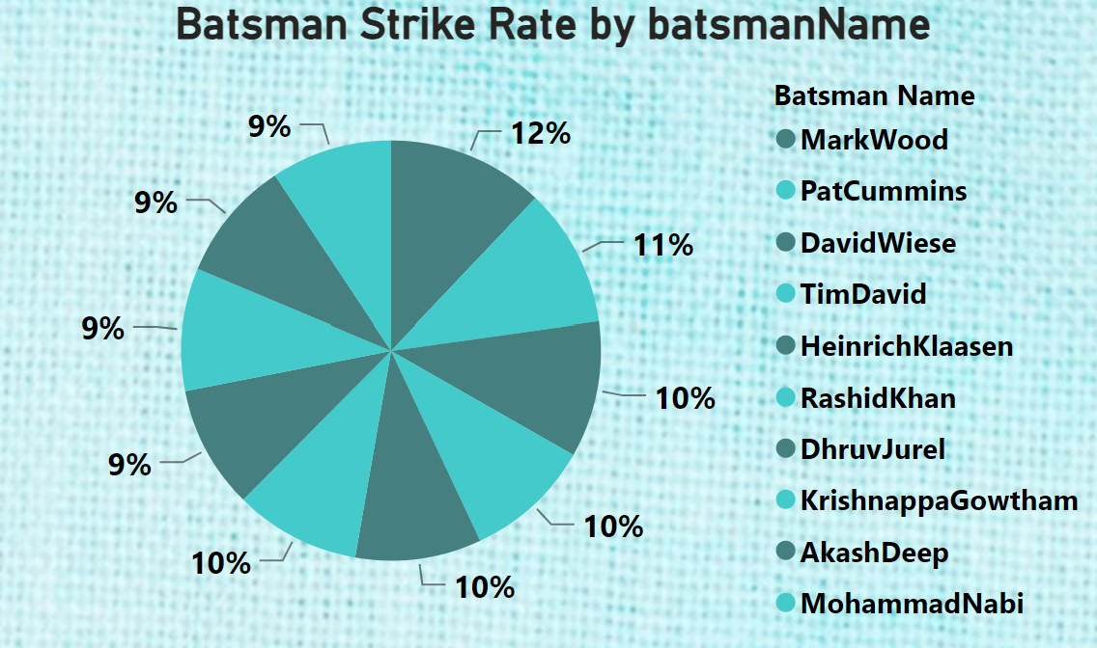
Top 10 batsmen based on strike rate
Mark Wood has the highest strike rate among the Batsmen shown at 220 (12%).
Pat Cummins and David Wiese have the next highest strike rates at 195 (11%) and 191 (10%) respectively.
Four Batsmen – Tim David, Heinrich Klassen, Rashid Khan and Dhruv Jurel – have a strike rate of 177 (10%).
The strike rates of Krishnappa Gowtham, Akash Deep, and Mohammad Nabi are clustered around 170-173 (9%).
The strike rates range from a low of 170 (9%) to a high of 220 (12%), showing a relatively narrow spread among the top 10 Batsmen.

Slide 10
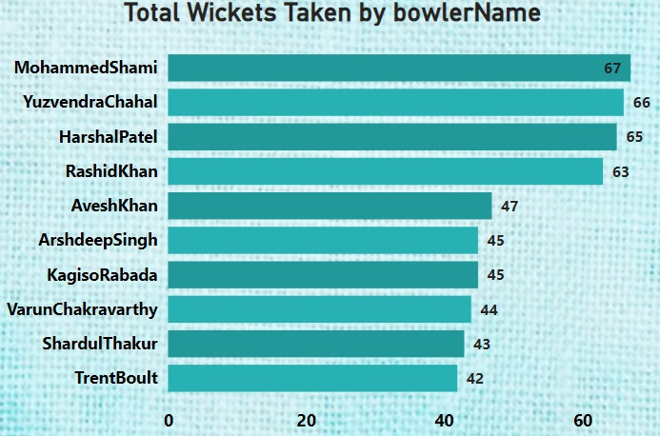
Top 10 bowlers based on total wickets taken
Mohammed Shami leads with 67 wickets,
Yuzvendra Chahal follows closely with 66 wickets.
Harshal Patel is not far behind with 65 wickets.
Rashid Khan has taken 63 wickets.
Avesh Khan follows with 47 wickets.
Arshdeep Singh and Kagiso Rabada have both taken 45 wickets each.
Varun Chakravathy, Shardull Thakur and Trent Boult are at the botton with 44, 43 and 42 wickets respectively.

Slide 11
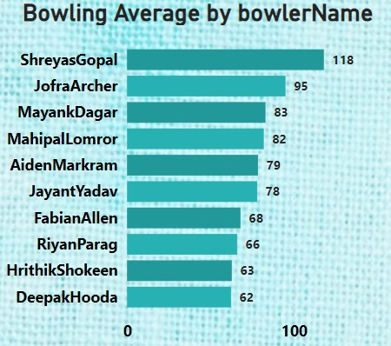
Top 10 bowlers based bowling average
Shreyas Gopal has the highest bowling average of 118.
Jofra Archer follows with a bowling average of 95%.
Mayank Dager (83%), Mahipal Lomror (82%) and Aiden Markram (79%) have bowling averages in the 80s.
Jayant Yadav (78%), Fabian Allen (68%), Riyan Parag (66%) and Hrithik Shokeen (63%) have bowling averages in the 60s and 70s.
Deepak Hooda has the lowest bowling average of 62%.

Slide 12
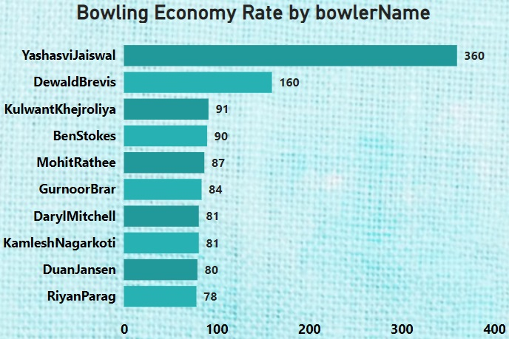
Top 10 bowlers based economy rate.
Yashasvi Jaiswal has the highest economy rate of 360.
Dewald Brevis followswith an economy rate of 160.
Kulwant Khejroliya and Ben Strokes have moderate economy rates of 91 and 90 respectively.
Several bowlers including Mohit Rathee, Gurnoor Brar, Dartl Mitchell, Kamlesh Nagarkot, Duan Jansen and Riyan Parag have economy rates clustered around 80.
The economy rates range from a low of 78 (Riyan Parag) to high of 360 (Yashasvi Jaiswal).

Slide 13
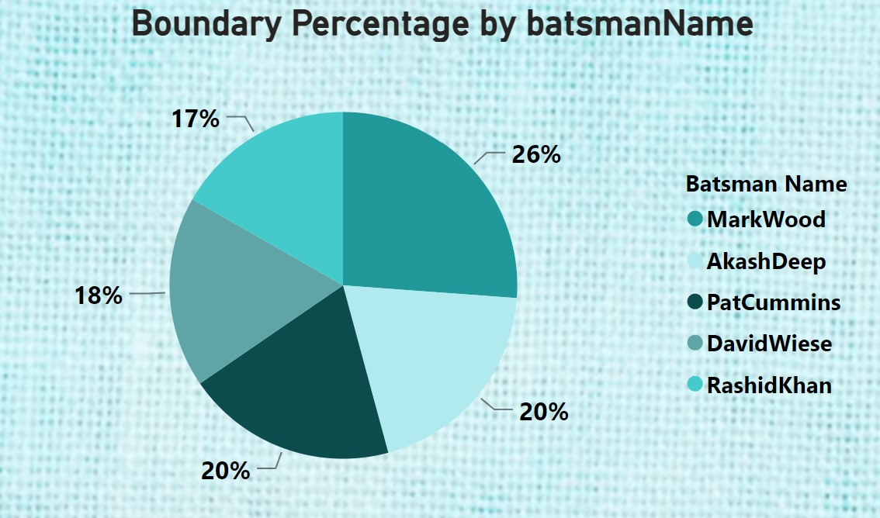
Top 5 batsmen based on boundary %
Mark wood has the highest boundary percentage, represented by the largest slice of the pie chart (26%).
Akash Deep and Pat Cummins both have a boundary percentage of 20%.
David Wiese and Rashid Khan have boundary percentage of 18% and 17% respectively.

Slide 14
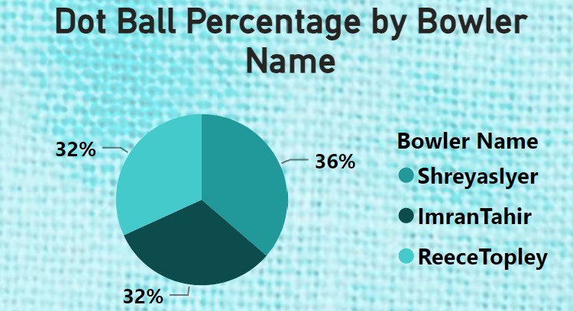
Top 3 bowlers based dot ball
Shreyas Iyer has a dot ball percentage of 36%.
Imran Tahir and Reece Topley both share the highest dot ball percentage of 32%.
All three bowlers have relatively high dot ball percentages, indicating their skill in bowling dot balls and containing runs.

Slide 15
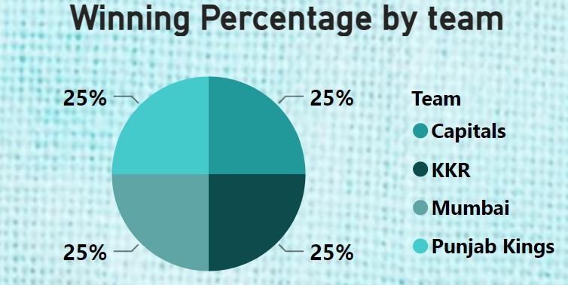
Top 4 teams based on winning %.
All four teams, namely Delhi Capitals, Mumbai Indians, Kolkata knight riders and Punjab Kings, have an equal winning percentage of 25% each.
No single team dominates or holds a significantly higher winning percentage compared to the others.
The even distribution of winning percentages highlights the close competition and parity between these top-performing teams over the past 3 years.
While the winning percentage are identical.

Slide 16
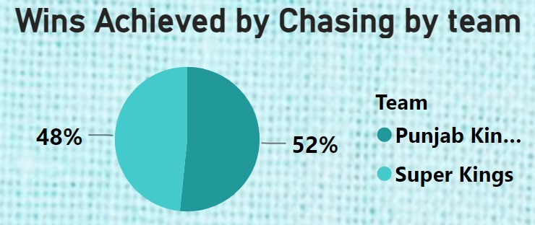
Top 2 teams with the highest number of wins achieved by chasing targets
The Punjab Kings have achieved the highest number of wins by chasing targets, with 16 wins, which accounts for 52% of their total wins.
The Chennai Super Kings have achieved a significant number of wins by chasing, with 15 wins, acoounting for 48% of their total wins.
The Chennai Super Kings have a slight edge over the Punjab Kings in terms of wins achieved by chasing, indicating their proficiency in successful run chases.

Slide 17
Secondary Analysis

Slide 18
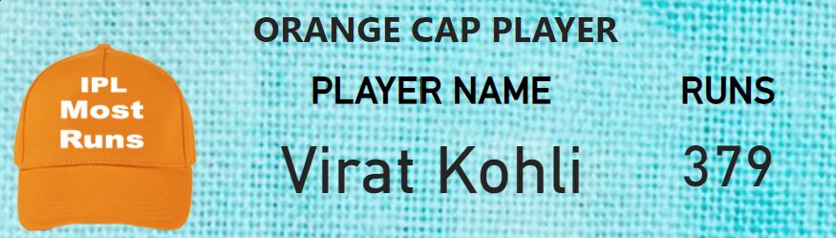
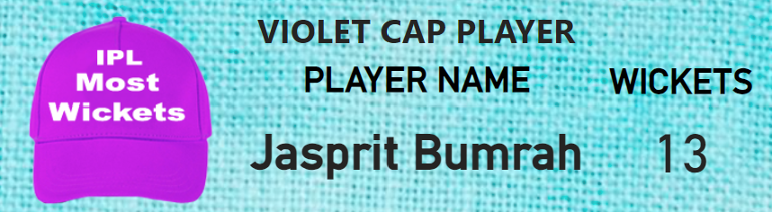
Orange and purple cap player
The Orange Cap is awarded to the batsman with the most runs scored in the IPL tournament.
The player named Virat Kohli has scored the highest number of runs, which is 379.
The Violet Cap is awarded to the bowler who takes the most wickets in the IPL tournament.
The player named Jasprit Bumrah has taken the highest number of wickets, which is 13.

Slide 19
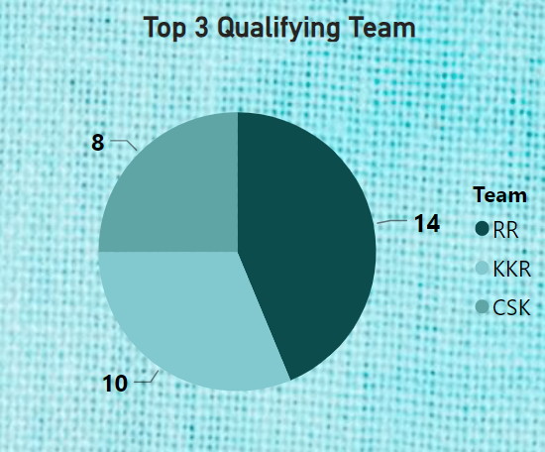
Top 3 qualifying teams
Dominant Performance by RR: RR secured a significant portion of 14 points, indicating they were the top – performing team during the league stage or qualifying rounds.
Closely contested: KKR, CSK has scored 10 and 8 points each respectively.

Slide 20
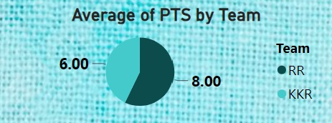
Winner and runner-up
The chart displays data of two teams: RR and KKR.
The team KKR has a higher average of PTS at 8.00.
The team RR has a lower average of PTS at 6.00.

Slide 21
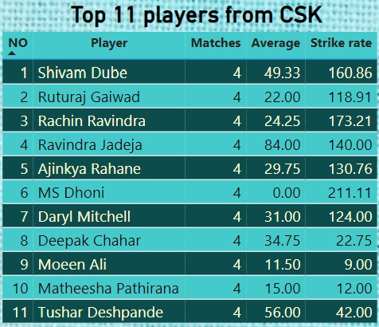
Best 11 players based on their positions

Slide 22
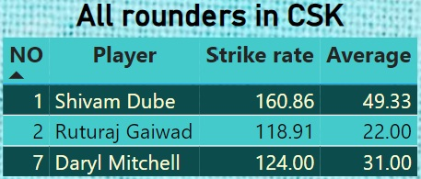
Pick your top 3 all-rounders

Slide 23
Conclusion
Player Performance: The data highlights the standout performances of players like Shubman Gill and Mohammed Shami, giving us a glimpse into potential starts for past 3 years.
Team Dynamics: Teams like KKR and CSK emerge as front runners based on their strong qualifying performances, setting the stage for an intense and competitive tournament.
Key Metrics: Metrics such as batting average, dot ball percentage, and economy rate offer valuable insights into players abilities and team strategies, aiding fans and analysts in understanding the game better.
Potential Contenders: With players like Virat Kohli and Yuzvendra Chahal showcasing their skills in previous seasons, we can expect them to remain key figures in the race for accolades like the Orange and Violet Cap.
Excitement Ahead: As we look forward to IPL 2024, armed with these insights, anticipation mounts for what promises to be another thrilling season of cricket, filled with unforgettable moments and fierce competition.

